Slide 1
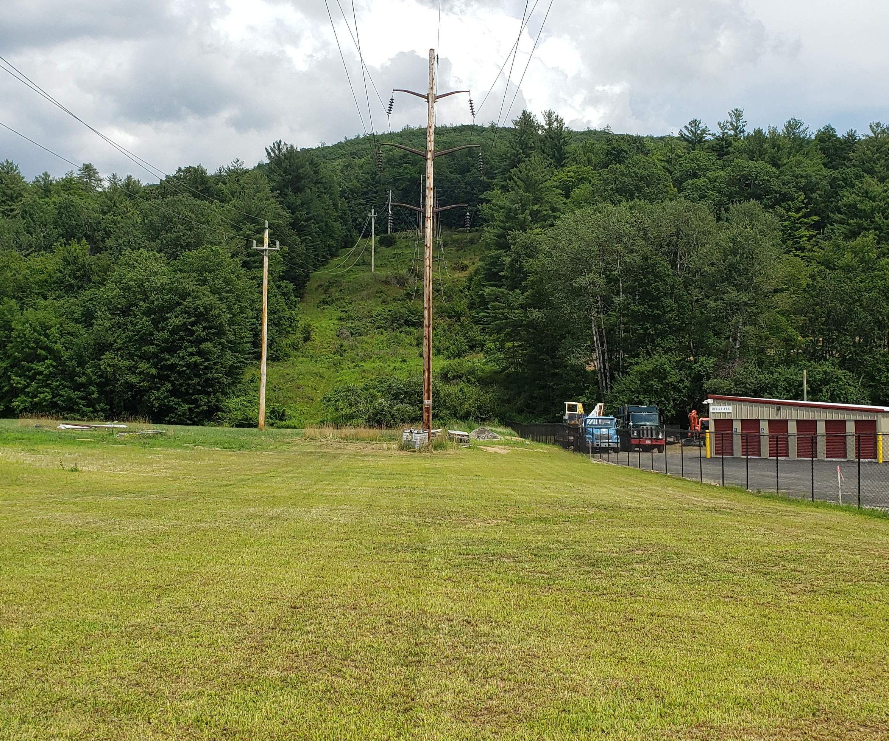
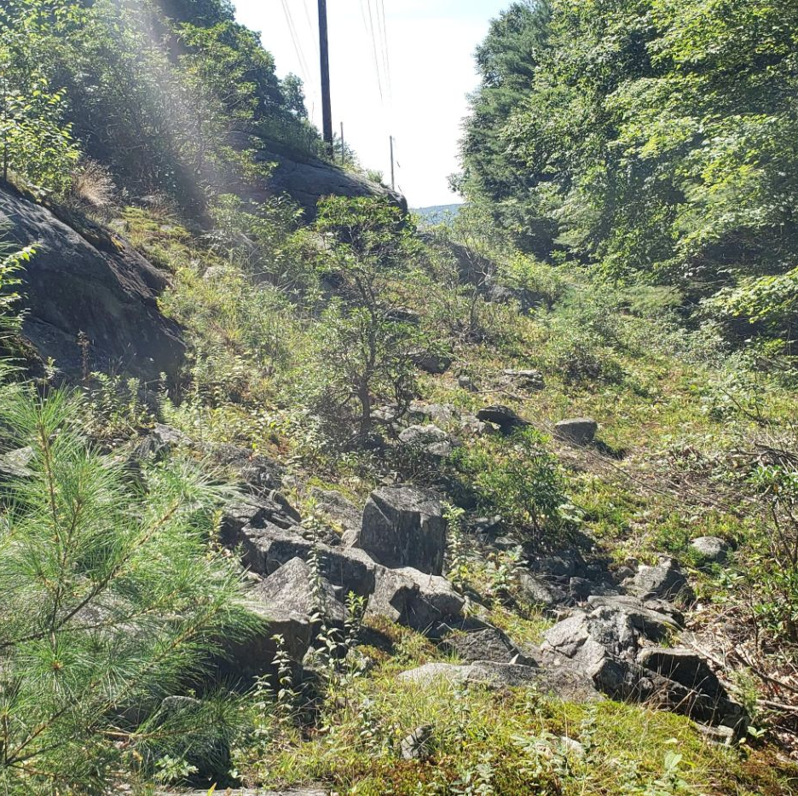
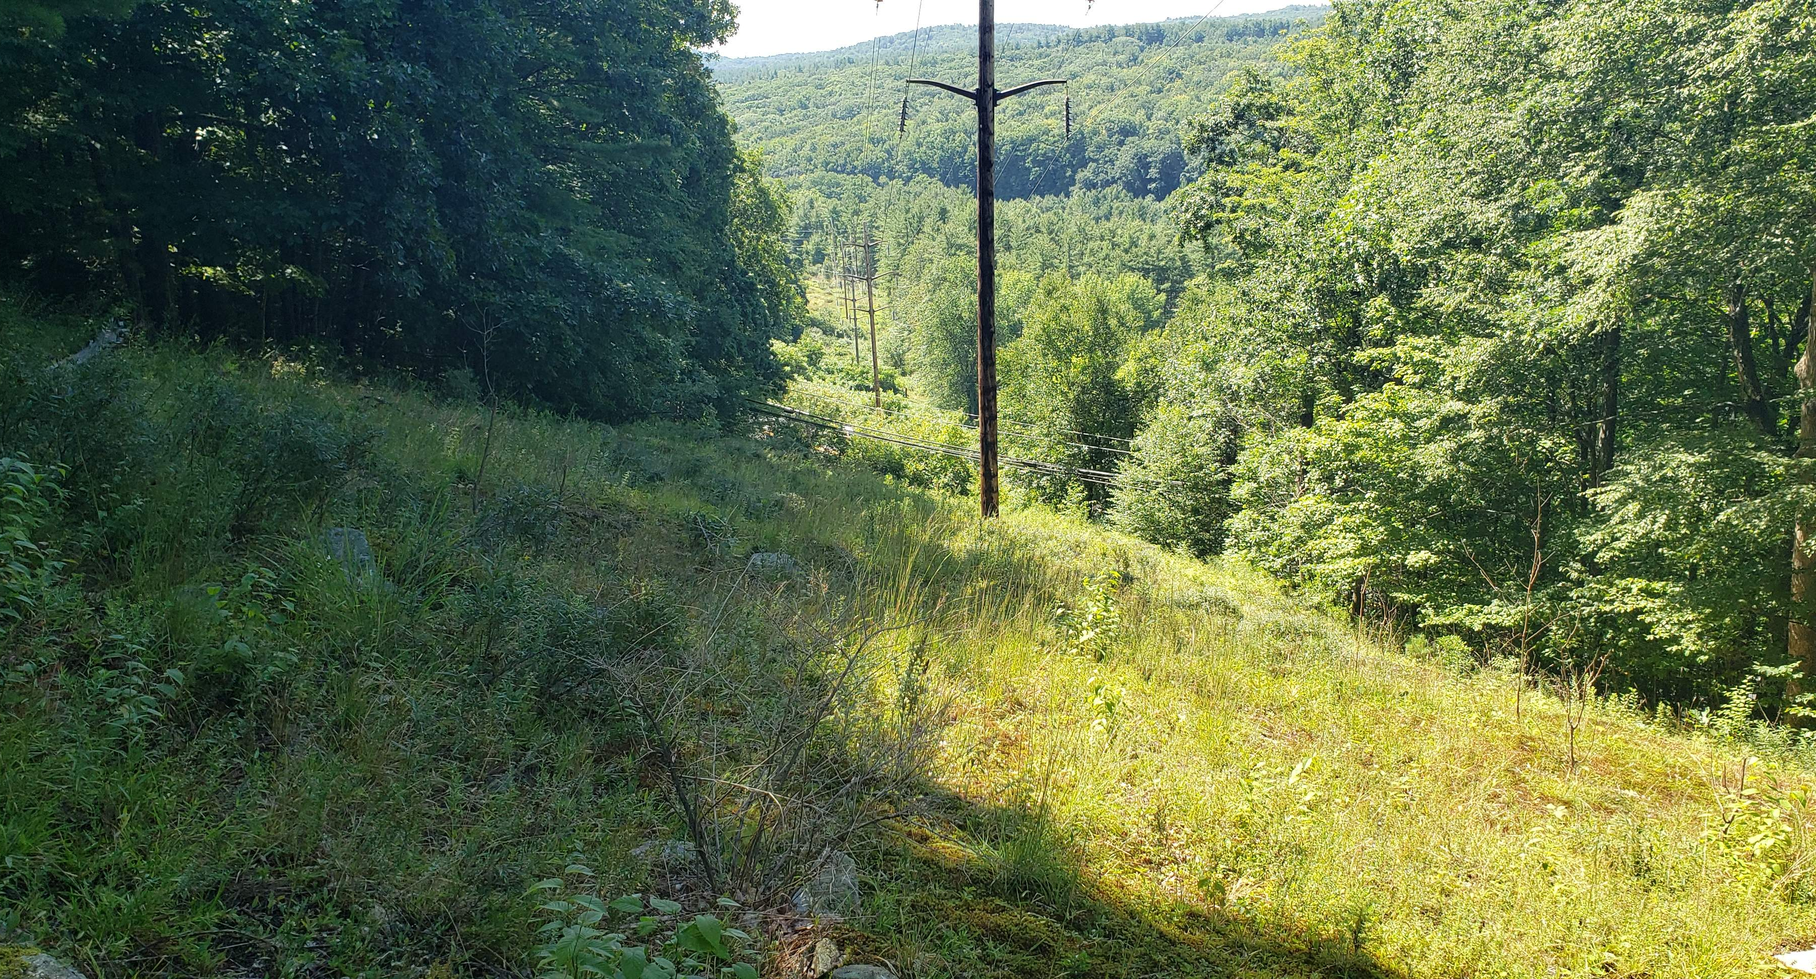
Central to Western Massachusetts Energy Improvement Project
Virtual Consultation Session and Site Tour
  February 12, 2025
Notes:
Will explain the project is on our E5F6 line and communicate reasoning for rebranding the project name- connect it to the towns/area.

Slide 2

Team Introduction
National Grid
  Mike Tyrrell
BSC Group
  Theresa Portante
  Julie Goldberg
  Priyanka Shrestha
| February 12, 2025

Slide 3
Agenda
  Project Overview
  Project Permitting Overview (Federal, State, Local)
  Environmental Justice and Community Engagement
  Anticipated Schedule Overview
  Virtual Site Tour
| February 12, 2025

Slide 4
Project Overview
History and Location
History
  E5/F6 Lines originally constructed in 1900s, original lattice structures remain along majority of line
  Lines were refurbished in 2001
Location
  Within Existing Right Of Way (ROW), 67 miles
  Deerfield #4 Substation, Shelburne to Millbury #305 Substation, Millbury
  There are seven existing Tap Lines within the Existing ROW, three of which will be reconstructed as part of this Project: the Quabbin Switch Tap Line, the Shutesbury #704 Tap Line, and the Deerfield #3 Tap Line
  Municipalities:
      Auburn
      Belchertown
      Conway
      Deerfield
      East Brookfield
      Leicester
      Leverett
      Millbury
      North Brookfield
      Pelham
      Shelburne
      Shutesbury
      Spencer
      Sunderland
      Ware
      West Brookfield
| February 12, 2025
Notes:
The existing E5/F6 mainline, constructed in the early 1900s and refurbished in 2001, are supported primarily on double-circuit lattice towers and steel pole structures, and the Tap lines are composed of steel and wood pole structures. The existing 69 kV Tap lines consist of the taps listed on the third Location bullet.
… Shelburne, Conway, Deerfield, Sunderland, Leverett, Shutesbury, Pelham, Belchertown, Ware, West Brookfield, North Brookfield, East Brookfield, Spencer, Leicester, Auburn, and Millbury, in descending order of the line. They are listed here in alphabetical order as well.

Slide 5
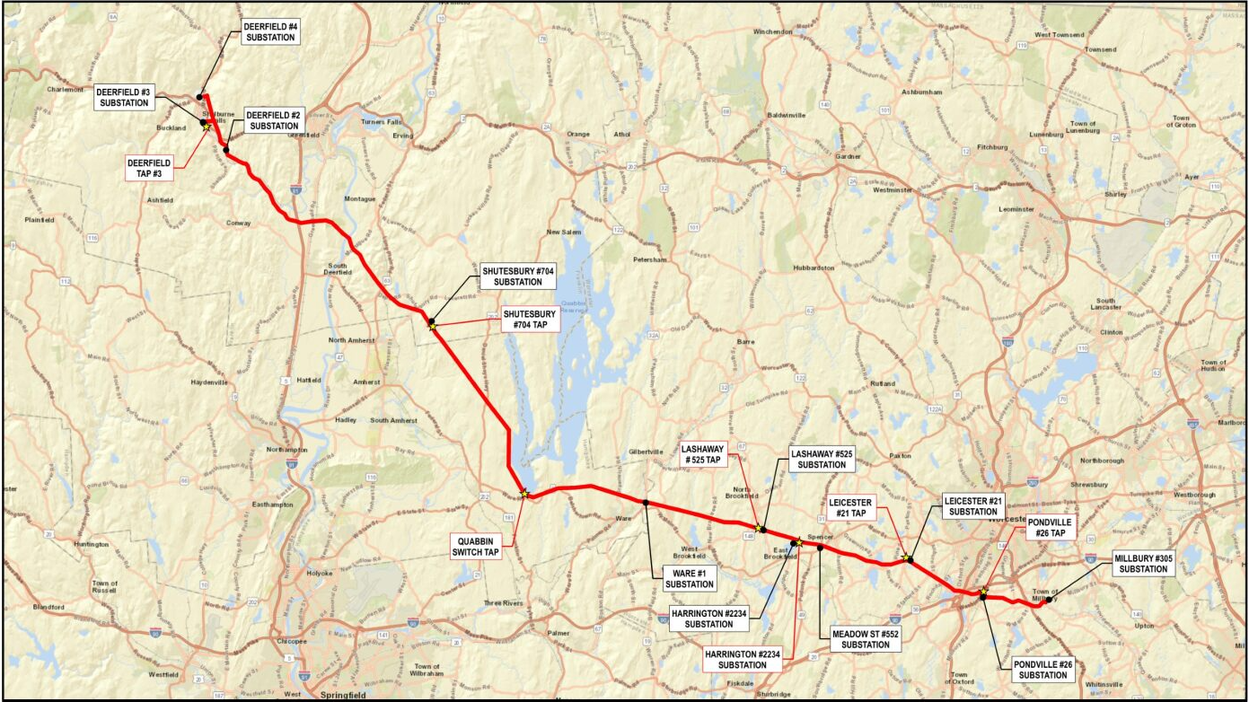
Project Overview
Overview Map
| February 12, 2025
Notes:
We wanted to provide a quick overview map of the Project area for orientation. The red displays the existing transmission line, the stars are the existing taps, and the black circles are substations.

Slide 6
Project Overview
Need, Benefits, and Scope
  Need and Benefits
  Address immediate reliability concerns
  Improve reliability and efficiency
  Support integration of renewable energy resources
  Scope
  Work on mainline and three taps:
      Replacement of existing lattice structures with monopoles
      Construction of new and/or improvement of existing access
      Reconductoring both circuits with 795 Aluminum Conductor Steel Supported for reliability and future operation at 115 kV
      Replacement of the existing shield wire with two Optical Ground Wires (OPGWs)
      Vegetation management for safe access and clearance requirements, including tree removals (estimated 241 acres across 67 miles) and mowing
| February 12, 2025
Notes:
Structures and wires are in need of replacement due to asset condition and aging infrastructure, and the access conditions vary considerably throughout the ROW. In some areas, the historic access route is in need of significant repair and does not meet NEP’s standard to safely support specialized equipment. The Project’s primary purpose is to complete required system improvements that will address poor asset condition, mitigate potential risks of electrical failure, and to provide long term reliable delivery of electrical service and maintenance of the lines. As part of the proposed refurbishment and to provide high speed communications between substations, optical ground wires (OPGWs) will be used to replace the existing shield wire.
NEP proposes to replace the degraded Lines and Taps within their existing ROWs, which will increase the reliability of the lines. The Project also includes installation of two new OPGWs, one for each line, which will provide improved fault protection and an upgraded communications path. The Rebuilt Lines and Taps will be designed with additional capacity to meet known and anticipated future requirements, including the interconnection of new distributed energy resources (DER), and increasing transfers of power over time to support electrification within the Commonwealth. The Rebuilt Lines and Taps will initially be operated at 69 kV but will be designed to allow for future operation at 115 kV as it becomes necessary in the future.
Project activities include: Replacing the existing double circuit lattice tower structures with weathering steel, double circuit, davit arm monopole structures. The replacement structures will provide improved reliability and climate resilience. Structures will either be supported by concrete caisson foundations or directly embedded into the ground. A total of 20 caisson foundations and 34 direct embeds are proposed for the Project, with one structure foundation yet to be determined. Performing access improvements, including grading and the addition of stone to existing access, as well as the construction of new access routes (where required). Replacing the existing copper conductor with 795 Thousands of Circular Mils (“MCM”) Aluminum Conductor Steel Supported (“ACSS”) conductor which will improve system reliability and allow the lines to operate at 115 kV at a future date. Replacing the existing shield wire with two OPGWs. These serve the dual function of providing shielding for the conductor, as well as allowing for high-speed communications between substations. And performing vegetation management (mowing and tree removals) to provide access to the proposed structure locations, to facilitate safe vehicular and equipment passage, to provide safe work sites for personnel, and to meet the conductor clearance requirements. Current conservative estimated total 241 acres of tree removals, which include fall in risk, removal for construction activities, selective removal, and pruning.

Slide 7
Project Overview
Existing Conditions
  Total Land Area (include Tap Lines): approximately 1,147 acres
  Open Space Area: 33%
  Wetland Resources include: Riverfront Area, Bordering Land Subject to Flooding, Isolated Vegetated Wetlands
  Delineated Wetland Count (including off-ROW): 315
  Stream Count (including off-ROW): 350
      Perennial Streams Count: 69
      Intermittent Streams Count: 281
  Delineated Vernal Pool Count (including off-ROW): 21 (10 are CVPs)
  NHESP Priority Habitat Area of Total Area: 19%
      Reptile Species Area: ~9%
      Plant Species Area: ~5%
      Bird Species Area: ~4%
      Amphibian Species Area: ~1%
      Dragonfly / Damselfly Area: <1%
      Fish Species Area: <1%
      Aquatic Invertebrate Species Area: <1%
| February 12, 2025
Notes:
The existing conditions released to natural resources are as follows.
Note: The NHESP Priority Habitat Area is listed in descending order, including the values listed as less than 1%.
Total land area is the land within the ROW and does not include OFF ROW access.

Slide 8
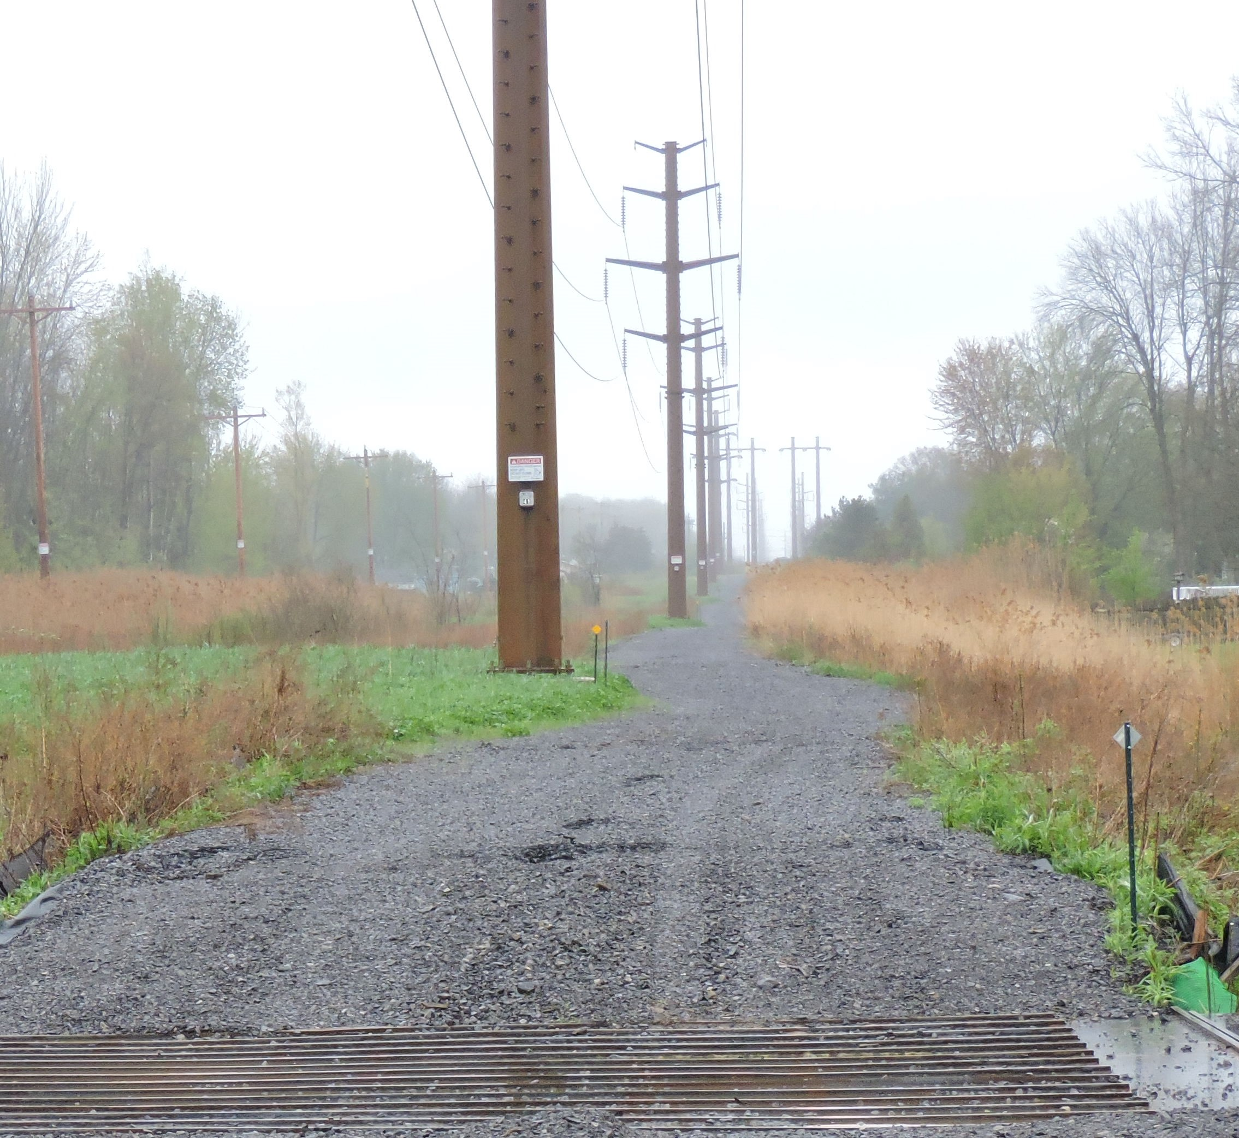
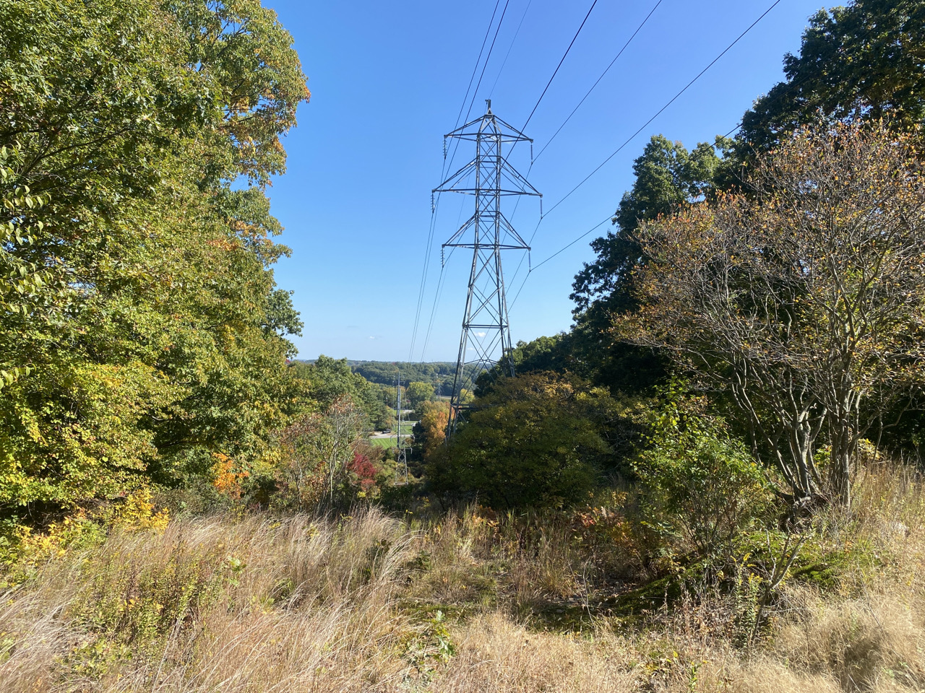
Project Overview
Mainline Structure Example
Typical E5/F6 lattice tower structure
Example of double circuit structure
| February 12, 2025
Notes:
Structures will range 5-25’ taller than the existing

Slide 9
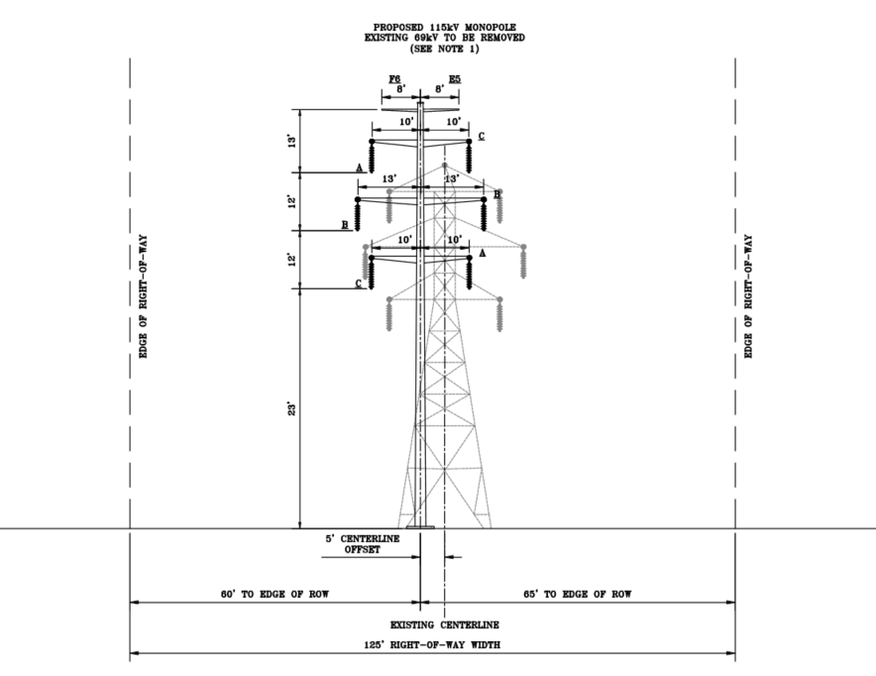
Project Overview
Mainline Cross-Section
| February 12, 2025
Notes:
This is a cross-section of the proposed structures, as discussed on the previous slide.

Slide 10
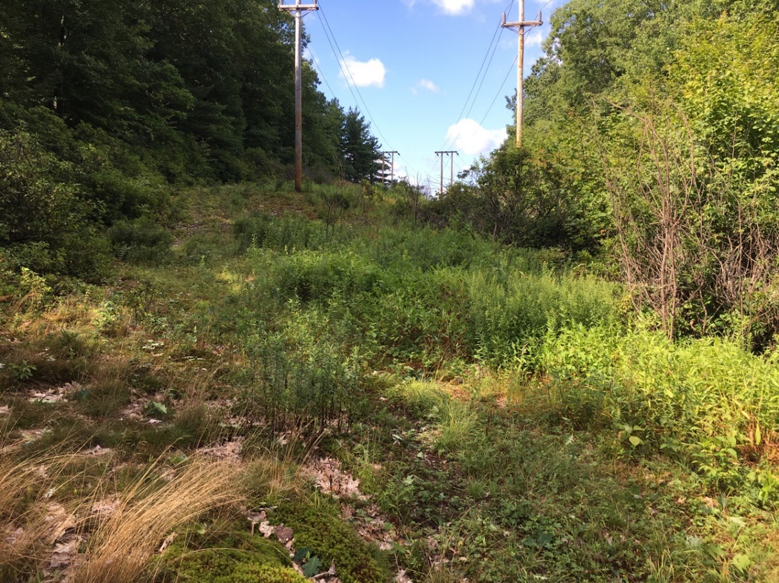
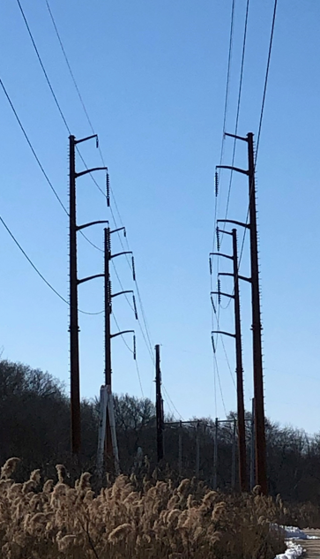
Project Overview
Deerfield and Quabbin Tap Lines Structure Example
Example of Tap Line Structures.
Example of proposed tap structures
| February 12, 2025
Notes:
The existing structures range in height from 40 to 50 feet for wooden monopole structures on the Deerfield Tap Lines, and 35 to 40 feet for various wood monopole structures on the Quabbin Tap Lines. The proposed structures have a similar height range to the mainline structures.

Slide 11
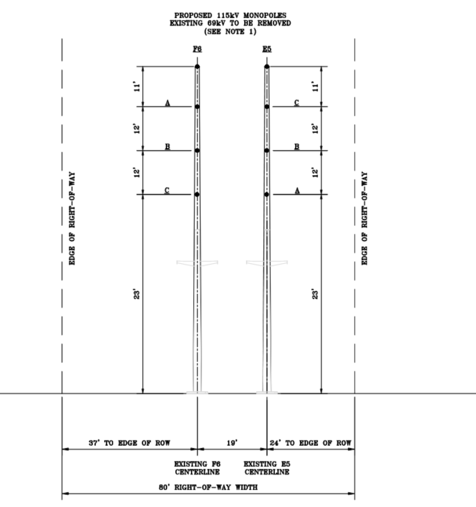
Project Overview
Deerfield #3 Tap Line Cross-Section
| February 12, 2025

Slide 12
Project Permitting Overview
Federal
  U.S. Army Corps of Engineers (ACOE)
      Authorization under Section 404 of the Clean Water Act
      Pre-construction Notification Permit
      Consultation under Section 106 of the National Historic Preservation Act
  United States Environmental Protection Agency (EPA)
      National Pollutant Discharge Elimination System (NPDES) General Permit for Stormwater Discharges and Construction Dewatering Activities
      Stormwater Pollution Prevention Plan (SWPPP)
| February 12, 2025

Slide 13
Project Permitting Overview
State
  Energy Facilities Siting Board (EFSB)
      Petition
  Executive Office of Energy and Environmental Affairs (EEA)
      MA Environmental Policy Act (MEPA) Review and Secretary’s Certificate
  MA Department of Environmental Protection (MA DEP)
      Section 401 Individual Water Quality Certificate and Variance
      Notice of Intent (NOI)
      Waterways Program – Ch. 91 Minor Modification
  MA Natural Heritage and Endangered Species Program (NHESP)
      MA Endangered Species Act – Project Review Checklist
      Conservation and Management Permit
  Department of Conservation and Recreation (DCR-W and S)
      Watershed Protection Act (WsPA) Permit
      Construction Access Permits (Separate permits from DCR-W and DCR-S)
| February 12, 2025

Slide 14
Project Permitting Overview
State (cont.) and Local
  Massachusetts Department of Transportation (MassDOT)
      Highway Crossing and Traffic Management Permit
  Massachusetts Historical Commission (MHC)
      Project review under Massachusetts General Law [M.G.L.] c. 9 § 27C
  MA State Historic Preservation Office (SHPO)
      Phase I and II Archeological Review
  Conservation Commissions within the Towns of Auburn, Belchertown, Conway, Deerfield, East Brookfield, Leicester, Leverett, Millbury, North Brookfield, Pelham, Shelburne, Shutesbury, Spencer, Sunderland, Ware, and West Brookfield
      NOIs
      Order of Conditions (OOCs)
| February 12, 2025

Slide 15
MEPA Review Thresholds
  ENF Review
  Wetlands, Waterways and Tidelands:
      Alteration of ½ or more acres of any other wetlands
      Alteration of 10 or more acres of any other wetlands.
      Alteration of 500 or more linear feet of bank along a fish run or inland bank
  Rare Species (potential – consultation with NHESP ongoing): Taking of an endangered or threatened species or species of special concern, provided that the Project site is two or more acres and includes an area mapped as a Priority Site of Rare Species Habitats and Exemplary Natural Communities
  ENF and Mandatory EIR
  EJ: The Secretary shall require an EIR for any Project that is located within a Designated Geographic Area around an EJ Population
  Land: Direct alteration of 50 or more acres of land, unless the Project is consistent with an approved conservation farm plan or forest cutting plan or other similar
  Wetlands, Waterways and Tidelands: Alteration of one or more acres of bordering vegetated wetlands (BVW)
| February 12, 2025
Notes:
Anticipated submittal of an ENF followed by a Draft Environmental Impact Report (DEIR) and Final Environment Impact Report (FEIR).

Slide 16
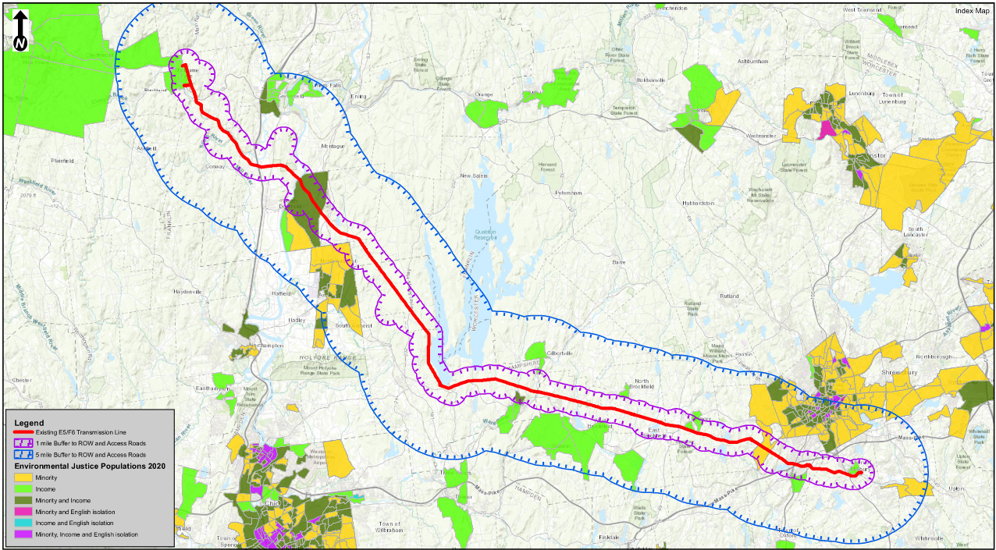
Environmental Justice
Overview Map
| February 12, 2025
Notes:
The three EJ criteria recognized by the EEA are the minority, low-income, and English Isolation EJ criteria. Within the Project area… 19 block groups meet EJ criteria, 13 of which meet the income criterion, three meeting the minority criterion, and three meet both criteria. Four of the 19 EJ Populations overlap with the Project Area, located in Shelburne, Sunderland, Leicester, and Millbury. No languages for translation are required as part of this Project, per the language spoken by 5% of a census tract’s population who do not speak English well or at all data layer. The Project team will still offer translation and interpretation services upon request.
The next slide provides more details on the 19 block groups.

Slide 17
Community Engagement
Public Involvement Plan
  Contacts
  EJ Reference List (obtained on 9/03/2024)
  Municipality Administrators
  Key Items of the Public Involvement Plan
  Project website: https://www.cmatowmaenergy.com/
  Municipality open houses and Select Board presentations (12/4/2023 to 9/17/2024)
  Advanced Notification
      EJ Screening Form emailed to MEPA and EJ Reference List (11/26/2024)
  Virtual Community Meeting (scheduled for 12/19/2024)
      Meeting ad published in newspapers: Worcester T&G (11/27/2024), Greenfield Recorder (11/27/2024), and the Republican/MassLive (11/29/2024)
      Meeting invitation shared with MEPA and contacts (11/27/2024)
  Consultation Session and Virtual Site Tour (2/12/2025)
  Extended comment period for the MEPA ENF (1/24/2025 to 2/27/2025)
  Project video will be created and shared to the Project website post-ENF filing
| February 12, 2025
Notes:
NEP is committed to engaging the public and EJ populations throughout this Project. A Project website has been created and is kept up to date with important materials and overview information. While no language thresholds are exceeded, we will provide translation, interpretation, hard copies of meeting materials, and other accommodations upon request. An updated EJ Reference List was requested in September, to augment the existing distribution list. Additionally, municipality administrator contacts from the open house process have been added to Project distribution and meeting invitations.
At this time, all municipalities have been involved in Project open houses, and presentations to Town select boards are complete. A table of these dates is shown on the following slide. Advanced Notification was provided on November 26th via the EJ Screening Form to MEPA and the EJ Reference List. A virtual community meeting has also been scheduled for December 19th. Notification of this meeting has been shared to three newspapers, which cover the counties for all municipalities involved. The Worcester Telegram and Gazette, the Greenfield Reporter, and the Republican have the highest circulation counts for the three counties included in the Project area: Worcester, Hampshire, and Franklin. These newspapers will also be used for distributing the ENF filing legal ad. Additionally, the meeting invitation was shared with the EJ Reference List and municipality administrators. All contacts were encouraged to participate and share the meeting to their respective websites, social media, and bulletins. A meeting notice was also posted to the Project website. Due to the proximity to Thanksgiving, which was accounted for in the newspaper dates, a reminder email will be sent the Monday prior to the meeting in case contacts missed the invitation over the holiday.
A Project video, similar to what has been provided for similar ACR projects, will be prepared after the ENF filing to share to the Project website.

Slide 18
Community Engagement
Municipal and Community Meetings
Date | Activities | Meeting Type/Location Held
September 17, 2024 | Millbury, Auburn, and Leicester Open House | In person – Millbury
July 17, 2024 | West Brookfield, East Brookfield, North Brookfield, and Spencer Open House | In person – West Brookfield
June 26, 2024 | Belchertown, Shutesbury, Pelham, and Ware Open House | In person – Belchertown
June 11, 2024 | Shelburne and Conway Open House | In person – Shelburne
June 5, 2024 | Sunderland, Leverett, and Deerfield Open House | In person – Sunderland
April 1, 2024 | Leicester Select Board Presentation | In person
March 26, 2024 | Millbury Select Board Presentation | Virtual
March 25, 2024 | Auburn Select Board Presentation | In Person
March 19, 2024 | Ware Select Board Presentation | Virtual
March 4, 2024 | West Brookfield Select Board Presentation | In Person
March 3, 2024 | Belchertown Select Board Presentation | Virtual
February 26, 2024 | Spencer Select Board Presentation | In Person
February 13, 2024 | Shutesbury Select Board Presentation | Virtual
December 18, 2023 | Conway and Pelham Select Board Presentation | Virtual
December 11, 2023 | Sunderland Select Board | Virtual
December 5, 2023 | Leverett Select Board Presentation | In person
December 4, 2023 | Shelburne Select Board Presentation | Virtual
| February 12, 2025
Notes:
The open houses and select board presentations are included in this table. All Towns were contacted for Select Board meetings, but some did not reply. Deerfield, North Brookfield, and East Brookfield did not respond, so the Project Team shared the presentation with them via email.

Slide 19
Anticipated Schedule Overview
  Field Assessments: 2022 to 2025
  Construction reviews, access reviews, land surveys, environmental field work, wetland delineations, resource testing, geotechnical soil borings
  Agency and Stakeholder Engagement: 2023 to 2025
  Mailed notifications, open houses, local meetings with municipalities and landowners, dedicated project hotline, project website
  Consultations were held with all agencies prior to ENF Filing
  Consultations will continue through the permitting process
  MEPA and Siting: 2024 to 2027
  Advanced Notification – EJ Screening Form 11/26/2024
  Environmental Notification Form (ENF) filing 01/15/2025
  EFSB Petition February/March 2025
  Construction: Spring 2029 to Spring 2035
| February 12, 2025

Slide 20
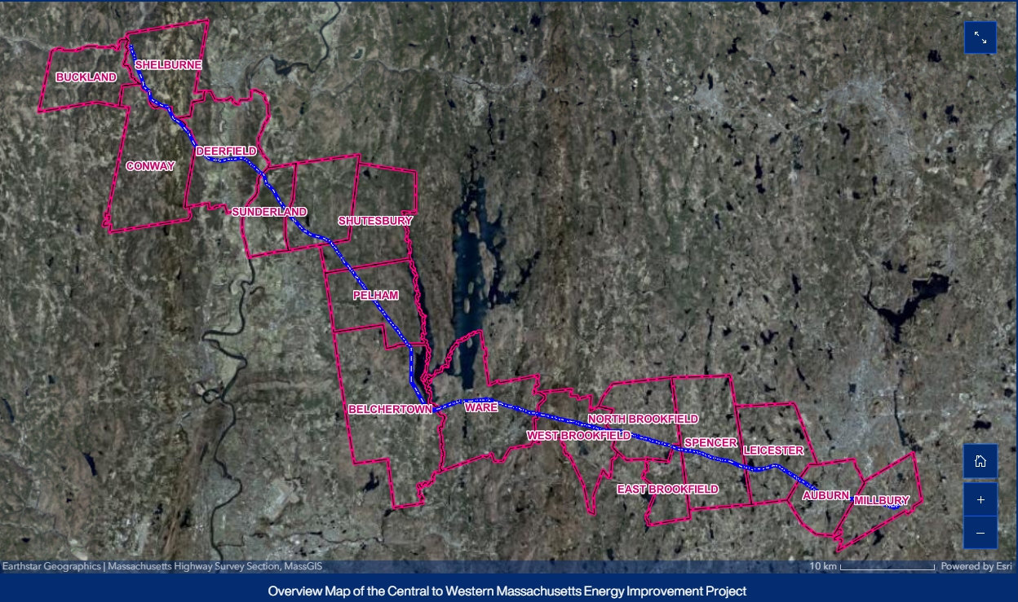
Virtual Site Tour
| February 12, 2025
Notes:
https://storymaps.arcgis.com/stories/f4eb74e284064f7198d222b11dbf3d02

Slide 21
Thank You
For more information, please visit or reach our Public Outreach team at: ​
​
Dedicated Project Hotline: 888-431-3536 ​
Email: info@CMAtoWMAenergy.com​
Website: www.CMAtoWMAenergy.com
| February 12, 2025

